Slide 1
Multiplicative relationships presented graphically
Understanding multiplicative relationships: percentages and proportionality

Slide 2
how to use Oak lessons

Slide 3
I can use a graph to represent a multiplicative relationship and connect to other known representations.

Slide 4
Variables are in proportion if they have a constant multiplicative relationship.
A ratio shows the relative sizes of two or more values and allows you to compare a part with another part in a whole.

Slide 5

Multiplicative relationships presented graphically
Percentages of amounts graphically
Other representations of proportional relationships

Slide 6
Percentages of amounts graphically
Fractions, percentages and ratio all show proportion. There are lots of ways to show this proportion.
For example, double number lines, bar models and ratio tables.

Slide 7
Percentages of amounts graphically
Using a bar model to find percentages of 240, we have:
10%
240
24 | 24 | 24 | 24 | 24 | 24 | 24 | 24 | 24 | 24
100%
Showing this on a double number line, we have:
0%
10%
100%
Percentage
Amount
0
24
240

Slide 8
Percentages of amounts graphically
%
We also know we can show relationships graphically.
For example, here is the same double number line showing 240 as a percentage
100
100
100
%
100
%
100
%
%
Amount | Percentage
240 | 100%
100
100
%
%
100
100
%
%
0
Amount
240

Slide 9
Percentages of amounts graphically
%
We also know we can show relationships graphically.
For example, here is the same double number line showing 240 as a percentage
100
Amount | Percentage
240 | 100%
Just like double number lines, graphs must be correctly scaled.
0
Amount
240

Slide 10
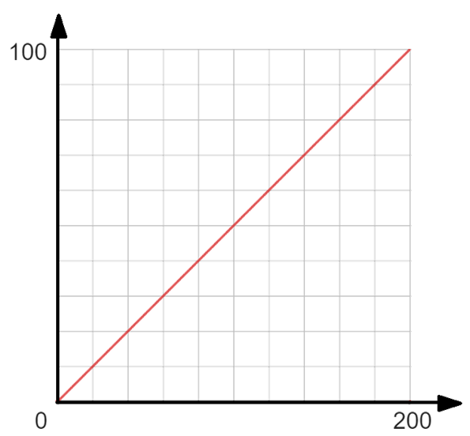


Percentages of amounts graphically
Which double number line is represented here?
%
x
a
0%
50%
0
200
b
You can see 100% = 200 plotted here
0%
100%
0
200
Amount

Slide 11
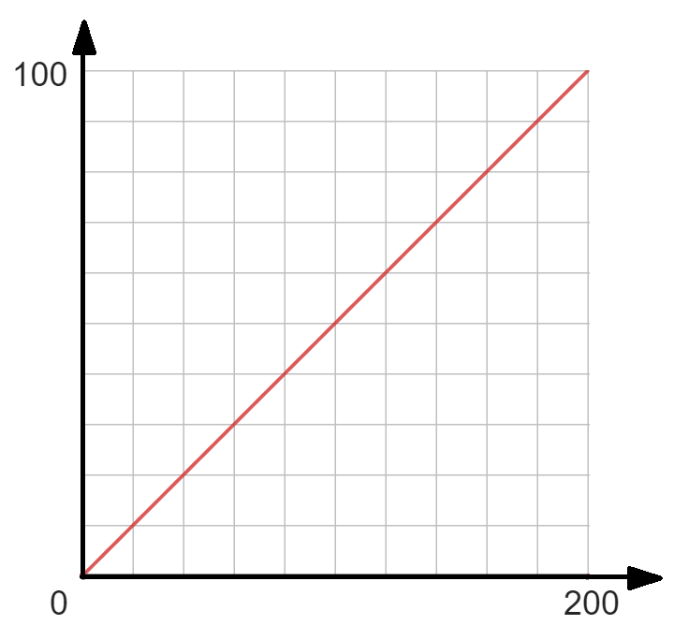
Percentages of amounts graphically
Using the graph, how do you think you can find 50% of 200?
%
The y axis:
100% ÷ 10 = each interval is 10%
Read the scale carefully
50
40
30
20
10
Amount

Slide 12
Percentages of amounts graphically
Using the graph, how do you think you can find 50% of 200?
%
What are the intervals for the x axis?
50
Amount

Slide 13
Percentages of amounts graphically
Using the graph, how do you think you can find 50% of 200?
%
200 ÷ 10 = 20,
Each interval is 20
50% of 200 = 100
50
40
Amount
20
60
80
100

Slide 14
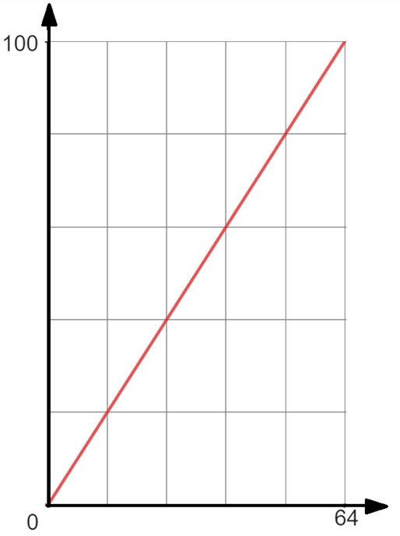
Percentages of amounts graphically
%
Using the graph, find 40% of 64
Identifying the intervals on the y axis.
100% ÷ 5 = Each interval is 20%
80
60
Identifying the intervals on the x axis.
64 ÷ 5 = Each interval is 12.8
40
40% of 64 = 25.6
20
12.8
25.6
38.4
51.2
Amount

Slide 15
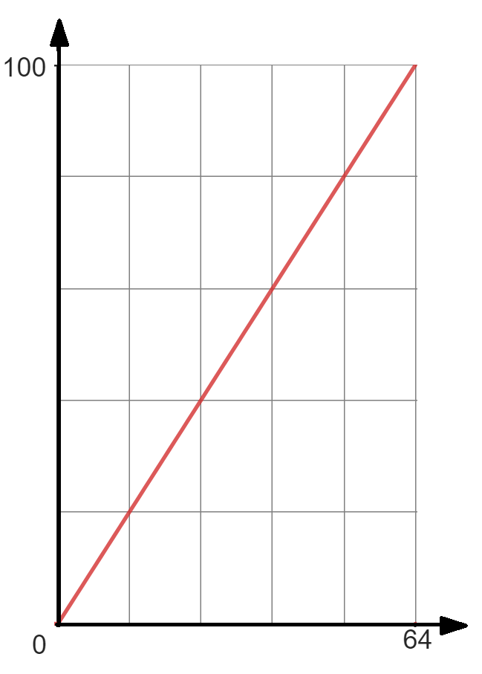
Percentages of amounts graphically
%
Why might it be difficult to state 59% of 64 using this graph?
80
How easy and accurate it is to work out the percentage of an amount using the graph depends on the accuracy of the graph and the scale on its axes.
60
40
20
12.8
25.6
38.4
51.2
Amount

Slide 16
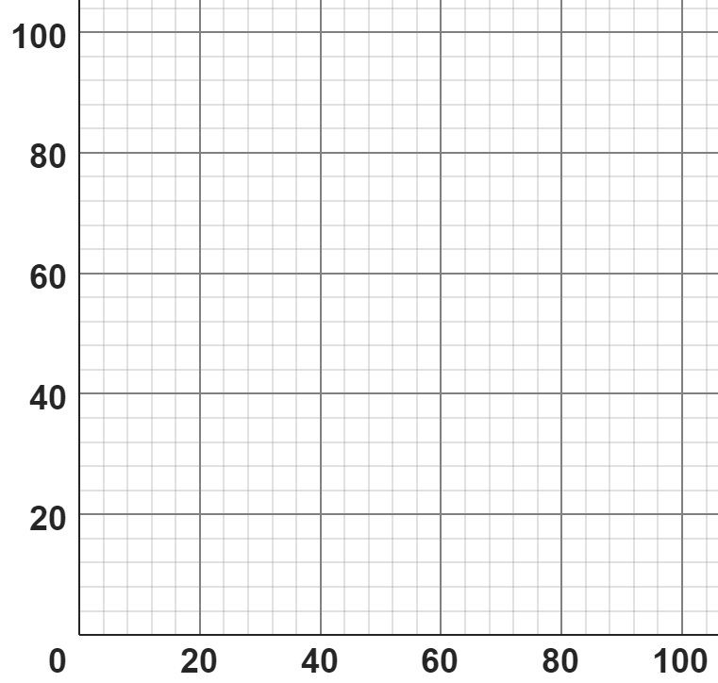
Percentages of amounts graphically
Match the double number line with the corresponding graph.
%
%
%
£
£
£
0%
80%
0%
100%
0%
80%
£0
£100
£0
£80
£0
£50

Slide 17
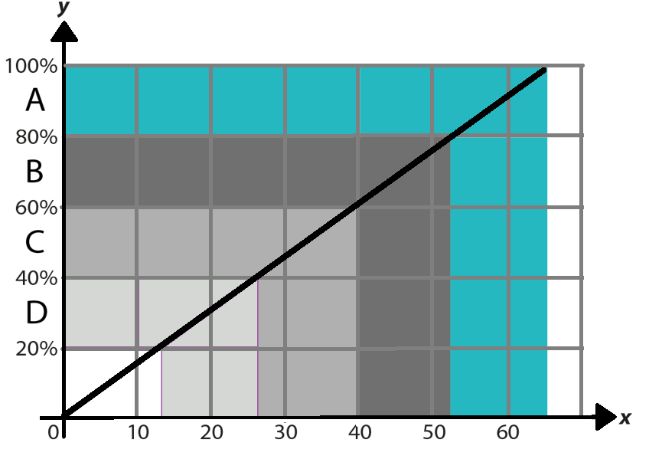

Percentages of amounts graphically
2) A class of students took a test. The grades available were A, B, C or D.
The graph helps the teacher convert a score out of 65 to a grade.
Jun scored 35 marks on his assessment.
a) What grade did Jun get?
b) Estimate his percentage score.
c) Estimate the minimum mark you need to get a grade. What calculation could you carry out to be more accurate?
Mark

Slide 18
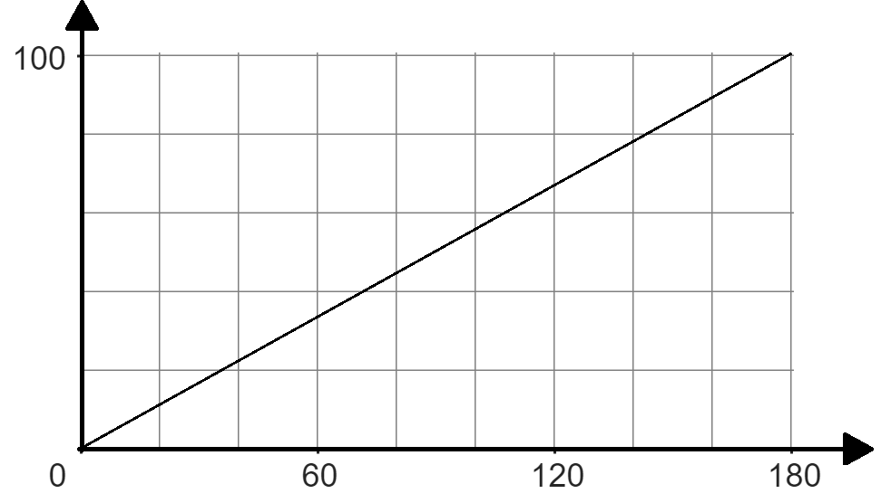
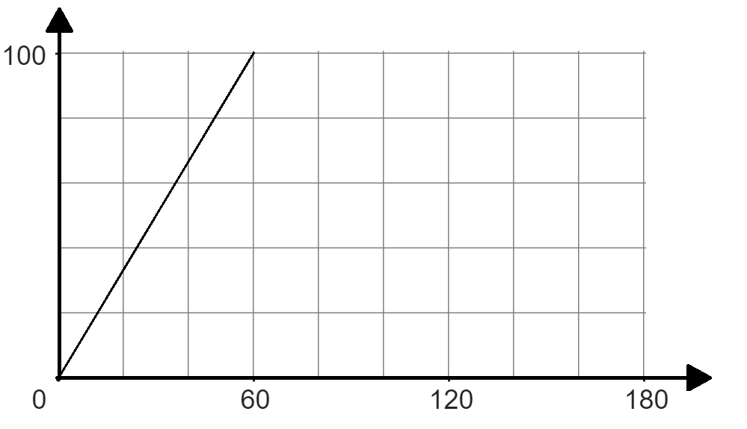
Percentages of amounts graphically
3a) Fill in the missing information given the graph and double number line.
%
%
£
£
£
40
100
20
100
%
%
£
£

Slide 19
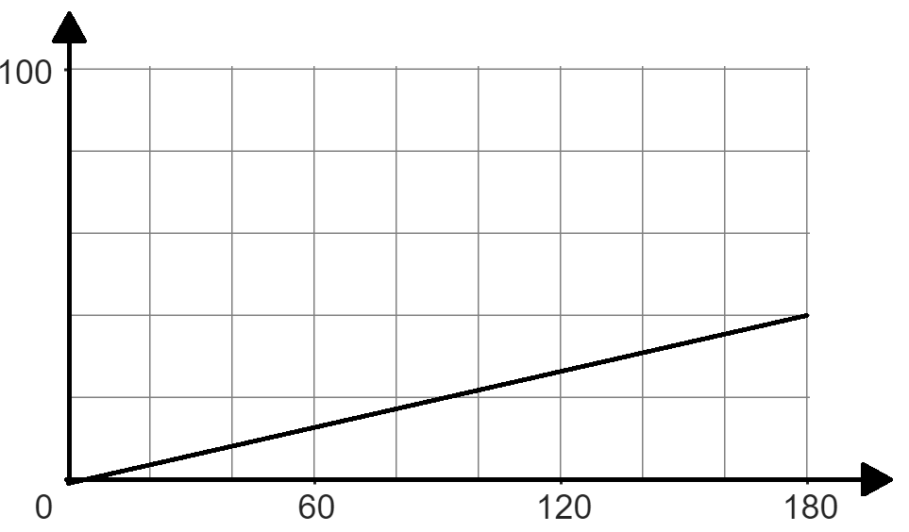
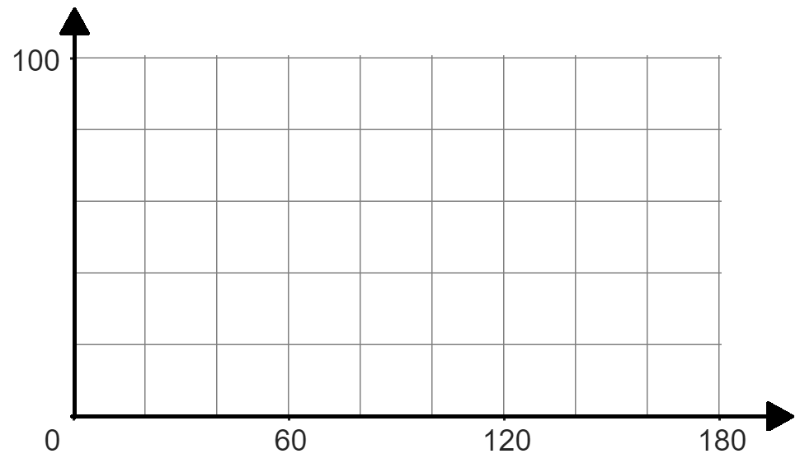
Percentages of amounts graphically
3b) Fill in the missing information given the graph and double number line.
%
%
£
£
.
100
33.3
100%
%
%
£
£
180
80
240

Slide 20
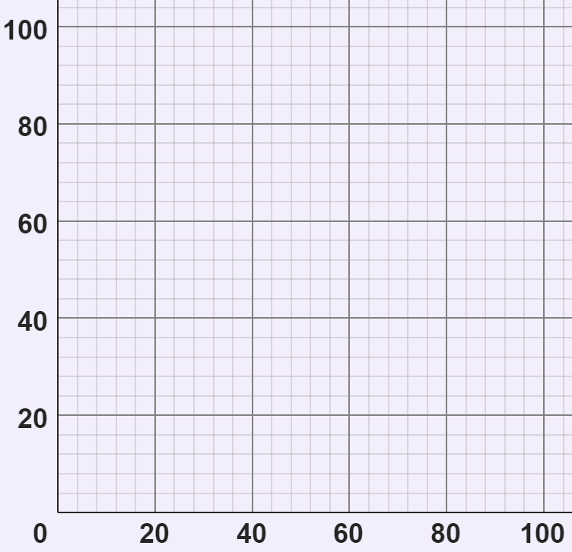
Percentages of amounts graphically
Match the double number line with the corresponding graph.
%
%
%
£
£
£
0%
80%
0%
100%
0%
80%
£0
£100
£0
£80
£0
£50

Slide 21
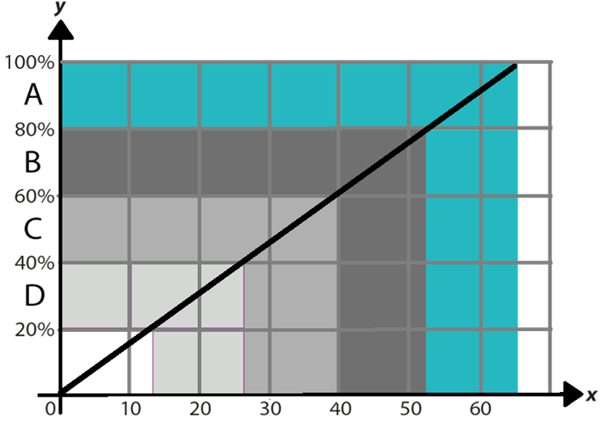
Percentages of amounts graphically
2) A class of students took a test. The grades available were A, B, C or D.
The graph helps the teacher convert a score out of 65 to a grade.
Jun scored 35 marks on his assessment.
a) What grade did Jun get?
35 marks is a grade C.
Mark

Slide 22
Percentages of amounts graphically
2) A class of students took a test. The grades available were A, B, C or D.
The graph helps the teacher convert a score out of 65 to a grade.
Jun scored 35 marks on his assessment.
b) Estimate his percentage score.
Jun scored 54% (an estimate between 50% and 60% is reasonable).
Mark

Slide 23
Percentages of amounts graphically
2) A class of students took a test. The grades available were A, B, C or D.
The graph helps the teacher convert a score out of 65 to a grade.
Jun scored 35 marks on his assessment.
c) Estimate the minimum mark you need to get a grade. What calculation could you carry out to be more accurate?
13 is the minimum mark needed for a grade. The calculation is 65 × 0.2 (or equivalent).
Mark

Slide 24
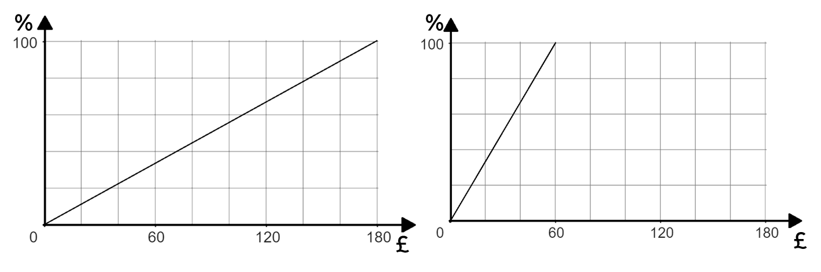
Percentages of amounts graphically
3a) Fill in the missing information given the graph and double number line.
40
100
20
100
%
%
£
£
72
180
12
60

Slide 25
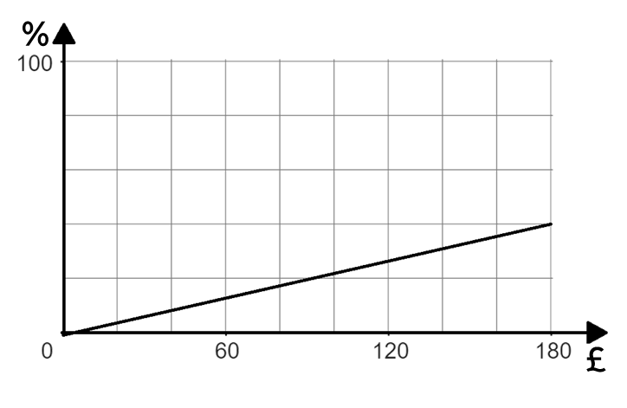
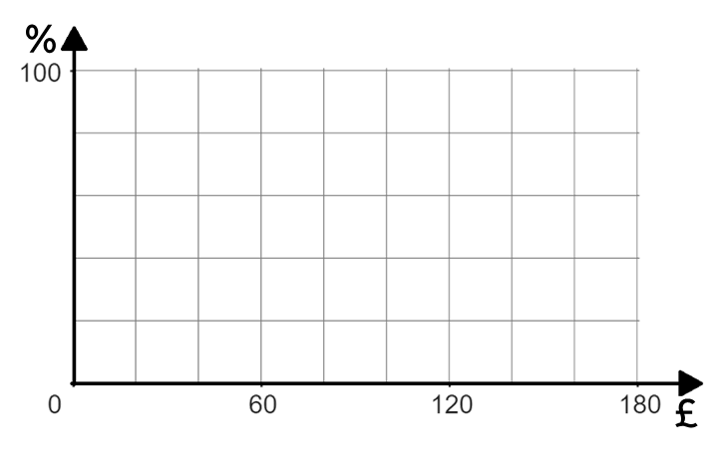
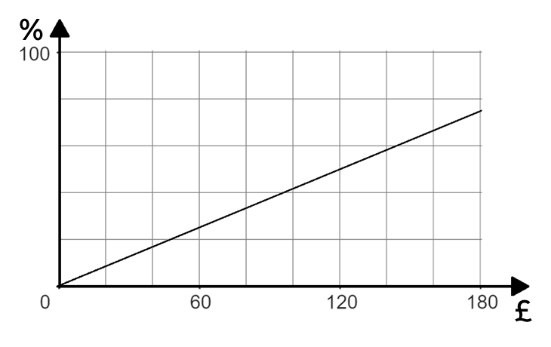
Percentages of amounts graphically
3b) Fill in the missing information given the graph and double number line.
.
40
100
33.3
100%
%
%
£
£
180
450
240
80

Slide 26
Multiplicative relationships presented graphically
Percentages of amounts graphically
Other representations of proportional relationships

Slide 27
Other representations of proportional relationships
You can use a ratio table to work with proportional relationships.
Amount | %
£2 | 10
£10 | 50
Amount | %
£2 | 10
£10 | 50
× 5
× 5
× 5
× 5
The multiplicative relationship is constant. Therefore, the amount and % are directly proportional to each other.
This is also true horizontally. For example, every £2 represents 10%.

Slide 28
Other representations of proportional relationships
How would you show 40% of 720 on a double number line?
× 4
10%
40%
100%
0%
Percentage
Amount
0
72
288
720
× 4

Slide 29
Other representations of proportional relationships
This could be shown in a ratio table.
Amount | %
720 | 100
This shows the 100%
This shows the 10%
÷10
÷10
This shows the 40%
72 | 10
×4
×4
288 | 40
× 4
10%
40%
100%
0%
Percentage
Amount
0
72
288
720
× 4

Slide 30
Other representations of proportional relationships
Amount | %
720 | 100
72 | 10
288 | 40
We can also graph this proportional relationship.

Slide 31
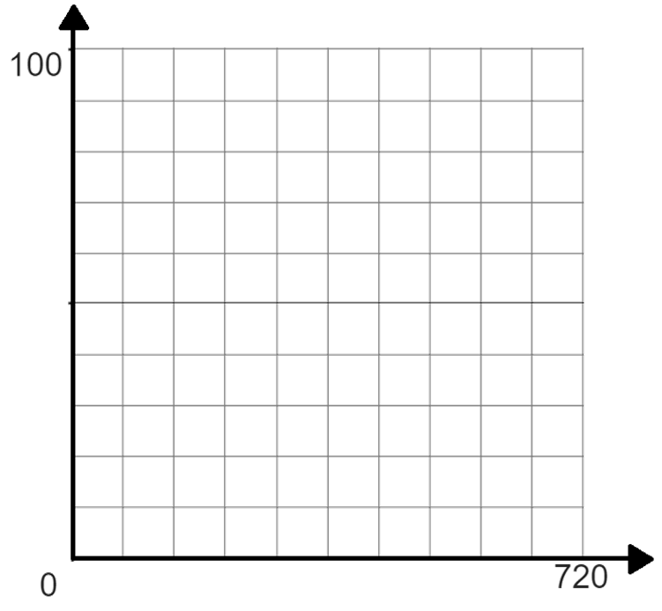
Other representations of proportional relationships
%
x
Amount | %
720 | 100
720 | 100
72 | 10
72 | 10
288 | 40
288 | 40
Remember, working out the percentage of an amount using the graph is dependent upon the accuracy of the graph and its axes.
x
x
Amount

Slide 32
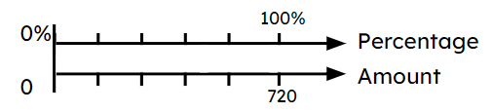
Other representations of proportional relationships
%
Amount | %
720 | 100
72 | 10
3 different representations showing the same proportional relationship.
Amount

Slide 33
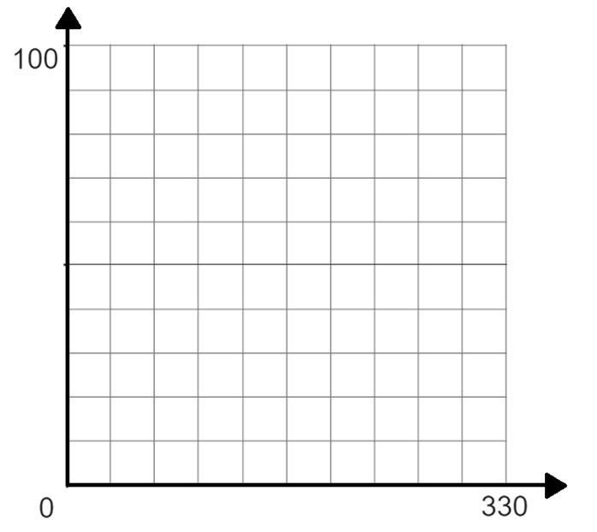
Other representations of proportional relationships
Fill in the ratio table using the graph. Then use the ratio table to work out 65%.
%
Amount | %
 | 100
330 | 100
÷10
÷10
33 | 10
×5
×5
165 | 50
÷10
÷10
16.5 | 5
214.5 | 65
Amount

Slide 34
Other representations of proportional relationships
1) Write what you think are the advantages and disadvantages of using a graph, double number line and ratio table when trying to find a percentage of an amount.
 | Graph | Double number line | Ratio table
Advantages
Disadvantages

Slide 35
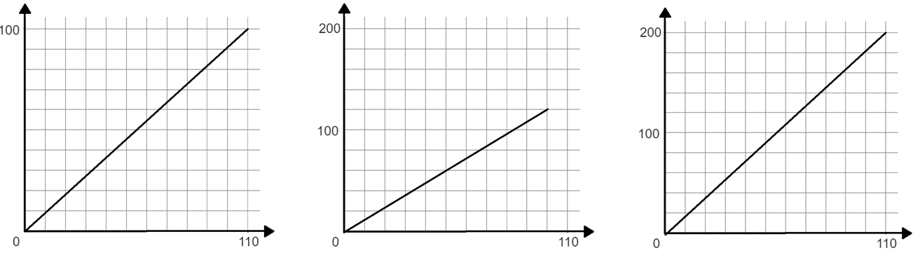
Other representations of proportional relationships
2) Match the ratio table with the correct graph and work out the missing amount using the ratio table.
Amount | %
110 | 100
 | 55
Amount | %
55 | 100
 | 55
Amount | %
100 | 120
 | 36
%
%
%
A
A
A

Slide 36
Other representations of proportional relationships
1) Write what you think are the advantages and disadvantages of using a graph, double number line and ratio table when trying to find a percentage of an amount.
 | Graph | Double number line | Ratio table
Advantages
Disadvantages
Good visual representation
Good visual representation
Concise
Takes time to draw
Answers are dependent on the accuracy of the scale
Takes time to draw as it is scaled
Doesn’t show visual representation

Slide 37
Other representations of proportional relationships
2) Match the ratio table with the correct graph and work out the missing amount using the ratio table.
Amount | %
110 | 100
 | 55
Amount | %
55 | 100
 | 55
Amount | %
100 | 120
 | 36
60.5
30.25
30
%
%
%
A
A
A

Slide 38
Other representations of proportional relationships
2) Match the ratio table with the correct graph and work out the missing amount using the ratio table.
Amount | %
110 | 100
Amount | %
55 | 100
Amount | %
100 | 120
55
50%
27.5
50%
10
12%
5.5
5%
2.75
5%
30
36%
60.5
55%
30.25
55%

Slide 39
Multiplicative relationships presented graphically
We know fractions, percentages and ratio all show proportion.
Proportion can be represented a number of ways and in this lesson we have focussed on graphs, double number lines and ratio tables.
We have considered the advantages and disadvantages of each representation.

Slide 40

© Oak National Academy 2024.
Produced in partnership with Mathematics in Education and Industry.
Licensed on the Open Government Licence v3.0, except where otherwise stated. See Oak terms and conditions.

